Slide 1
Al - Rajhi Dashboards and Reports

Slide 2
Al Rajhi - BOD Dashboard - Landing Page

Slide 3
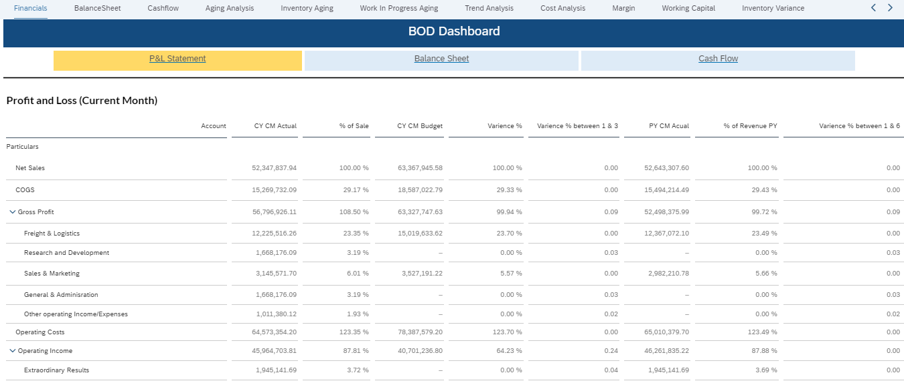
Al Rajhi - BOD Dashboard - Detailed Page

Slide 4
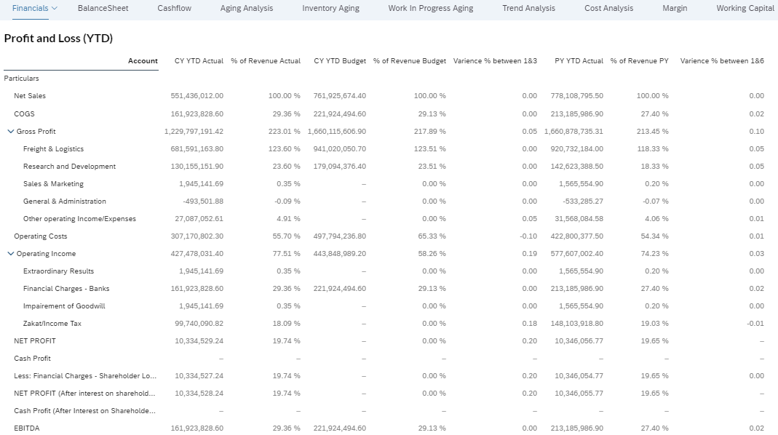
Al Rajhi - BOD Dashboard - Detailed Page

Slide 5
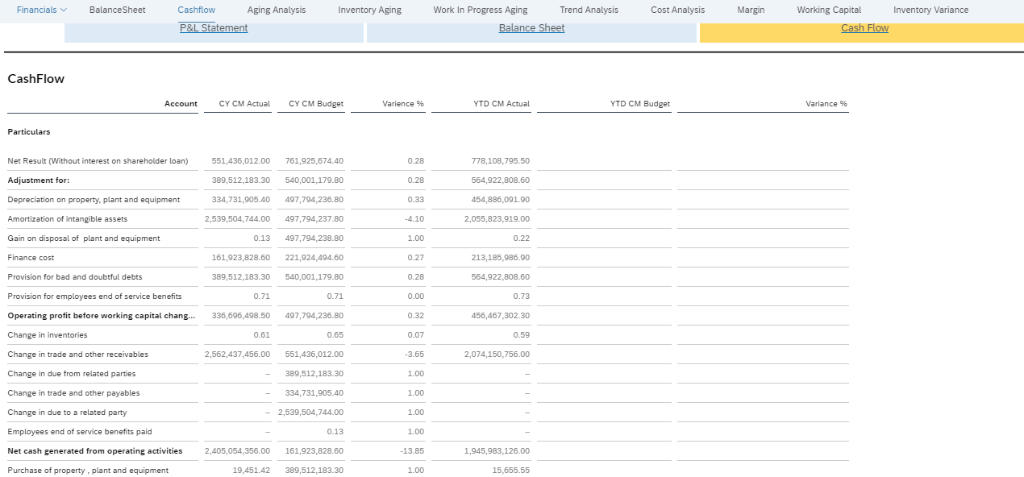
Al Rajhi - BOD Dashboard - Detailed Page

Slide 6
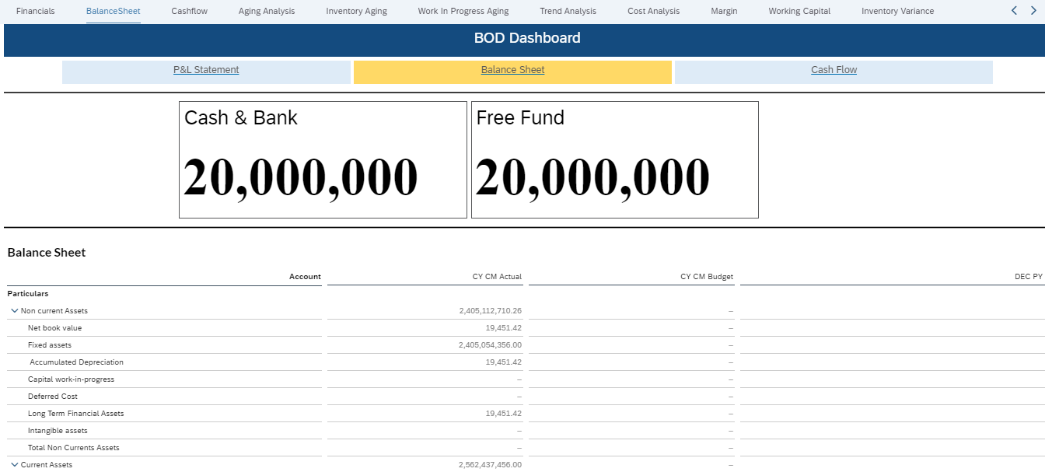
Al Rajhi - BOD Dashboard - Detailed Page

Slide 7
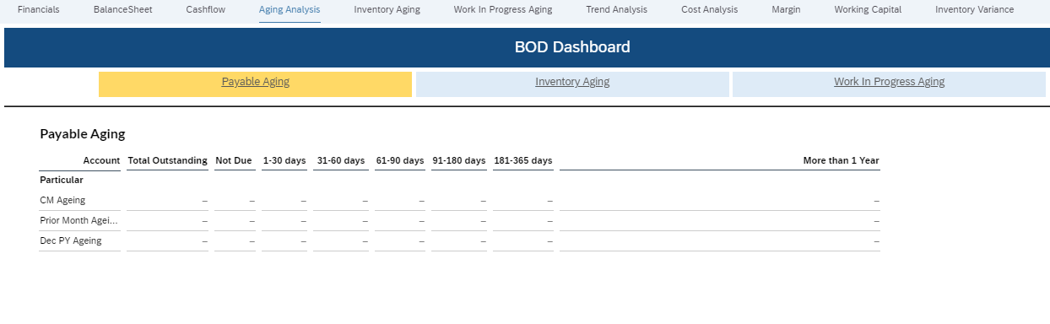
Al Rajhi - BOD Dashboard - Detailed Page

Slide 8
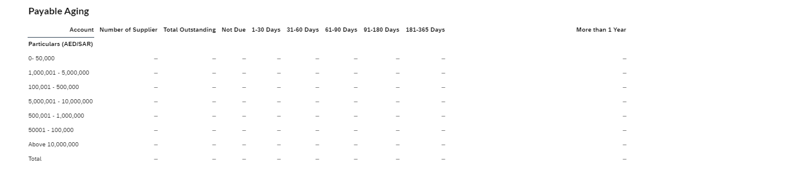
Al Rajhi - BOD Dashboard - Detailed Page

Slide 9
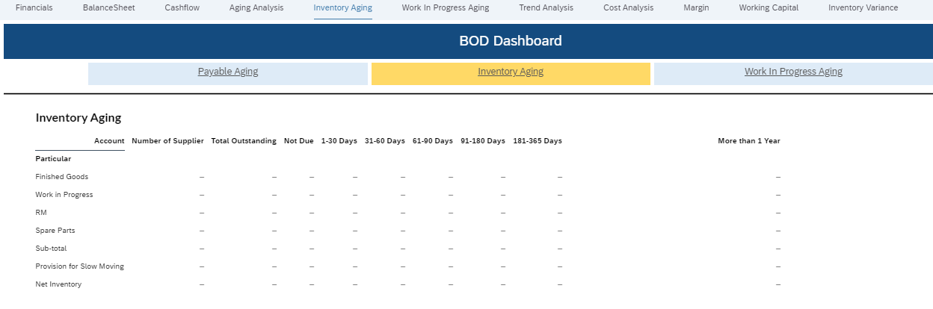
Al Rajhi - BOD Dashboard - Detailed Page

Slide 10
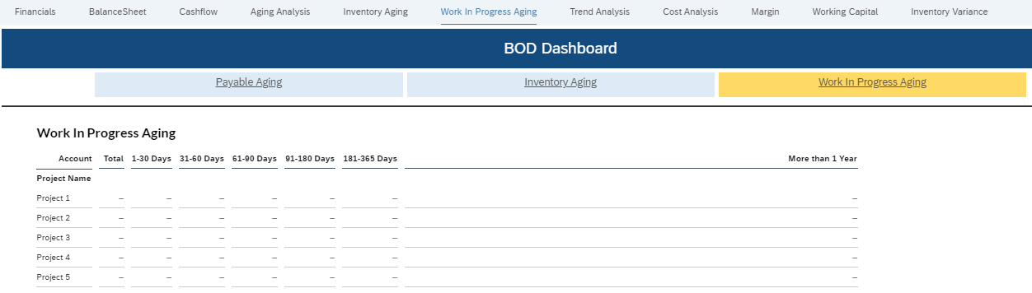
Al Rajhi - BOD Dashboard - Detailed Page

Slide 11
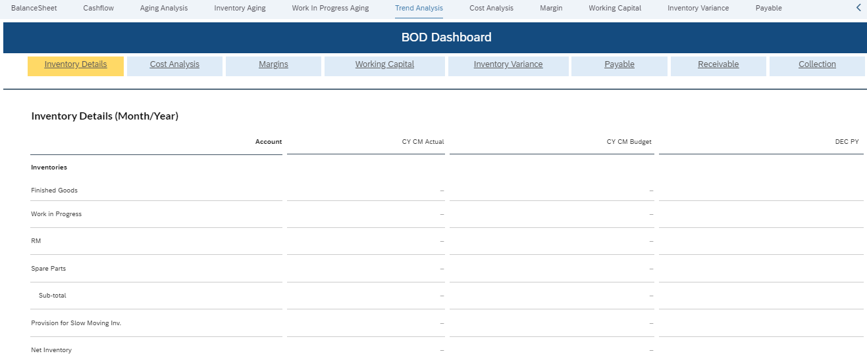
Al Rajhi - BOD Dashboard - Detailed Page

Slide 12
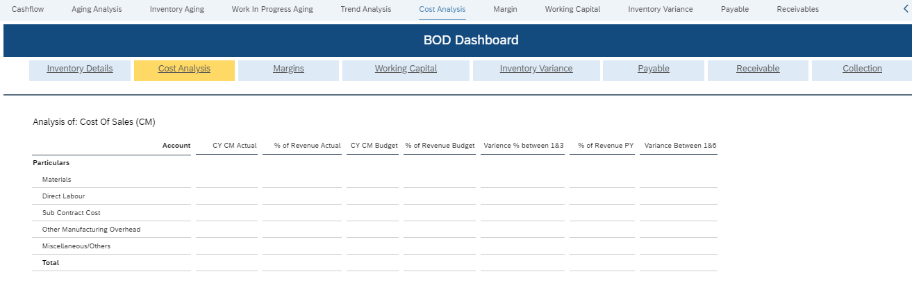
Al Rajhi - BOD Dashboard - Detailed Page

Slide 13
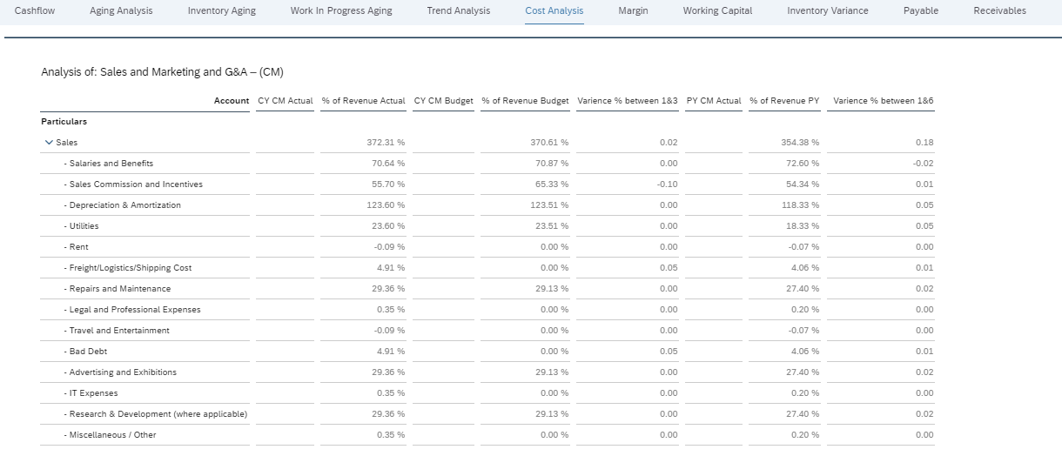
Al Rajhi - BOD Dashboard - Detailed Page

Slide 14
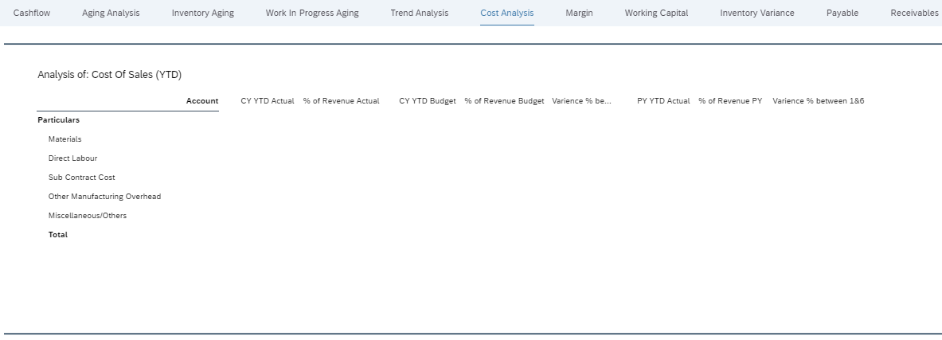
Al Rajhi - BOD Dashboard - Detailed Page

Slide 15
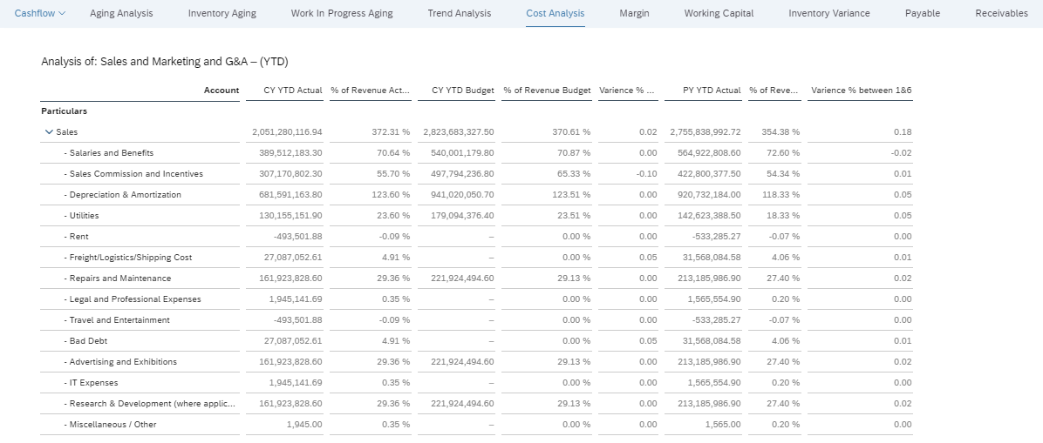
Al Rajhi - BOD Dashboard - Detailed Page

Slide 16
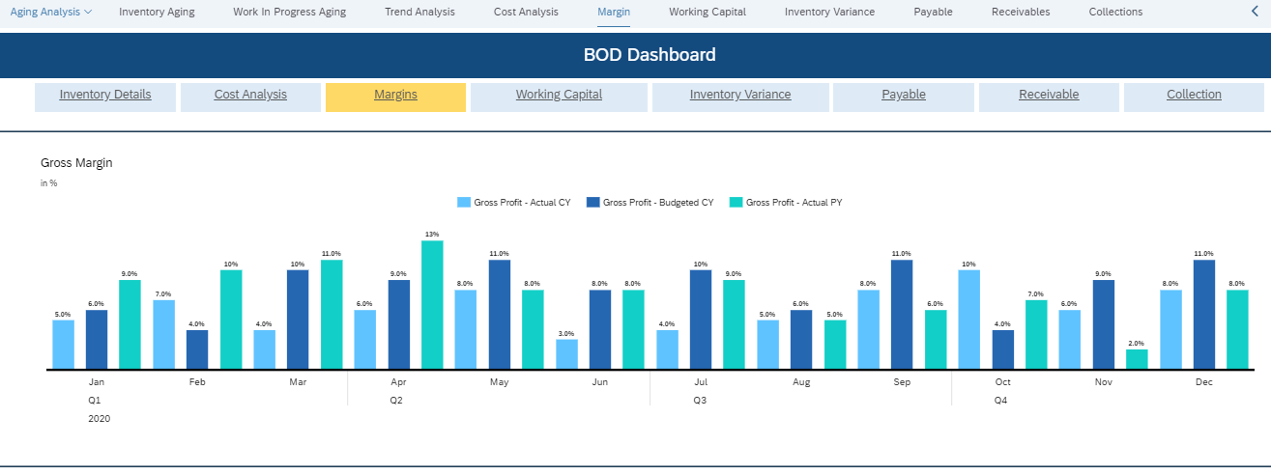
Al Rajhi - BOD Dashboard - Detailed Page

Slide 17
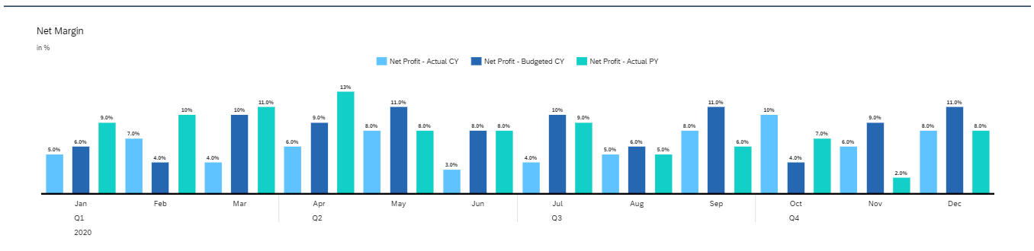
Al Rajhi - BOD Dashboard - Detailed Page

Slide 18
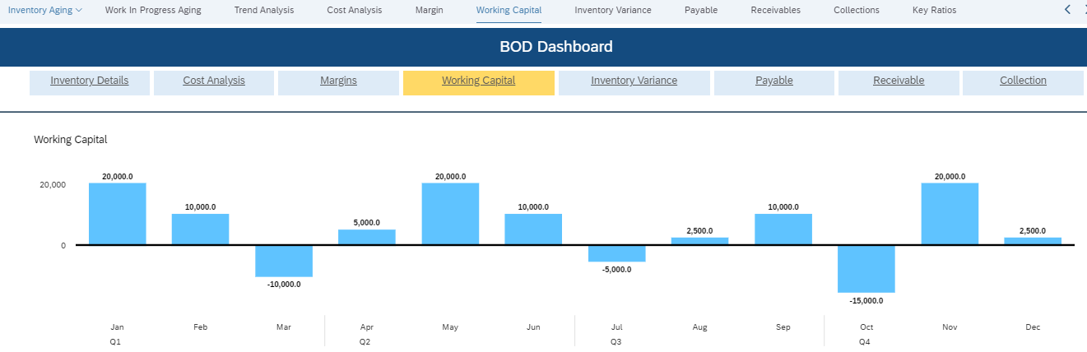
Al Rajhi - BOD Dashboard - Detailed Page

Slide 19
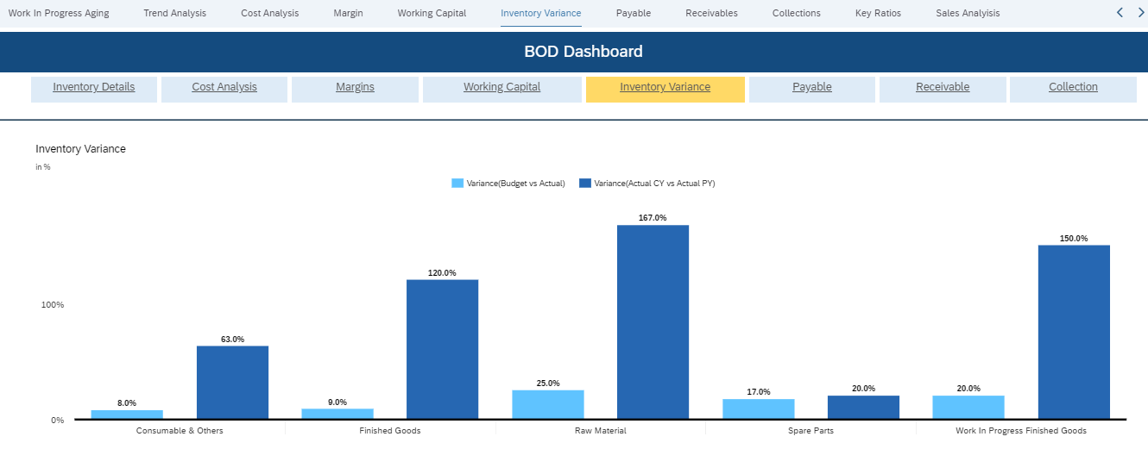
Al Rajhi - BOD Dashboard - Detailed Page

Slide 20
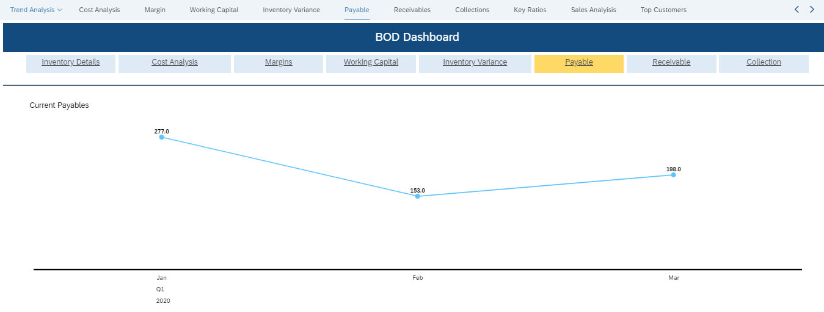
Al Rajhi - BOD Dashboard - Detailed Page

Slide 21
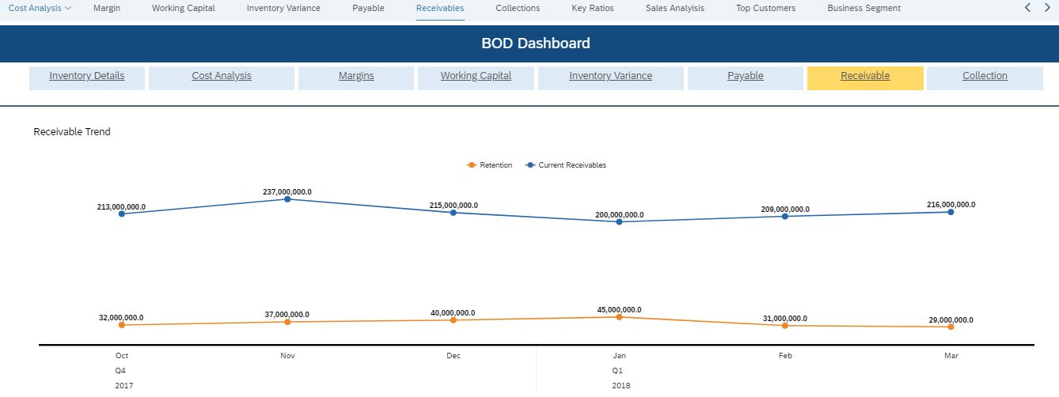
Al Rajhi - BOD Dashboard - Detailed Page

Slide 22
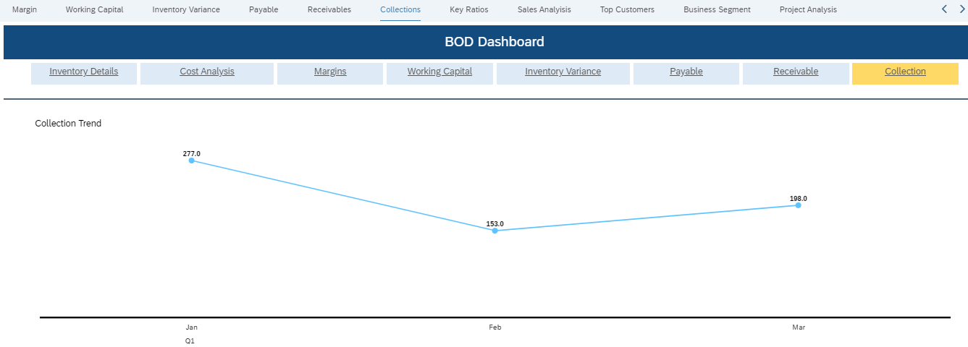
Al Rajhi - BOD Dashboard - Detailed Page

Slide 23
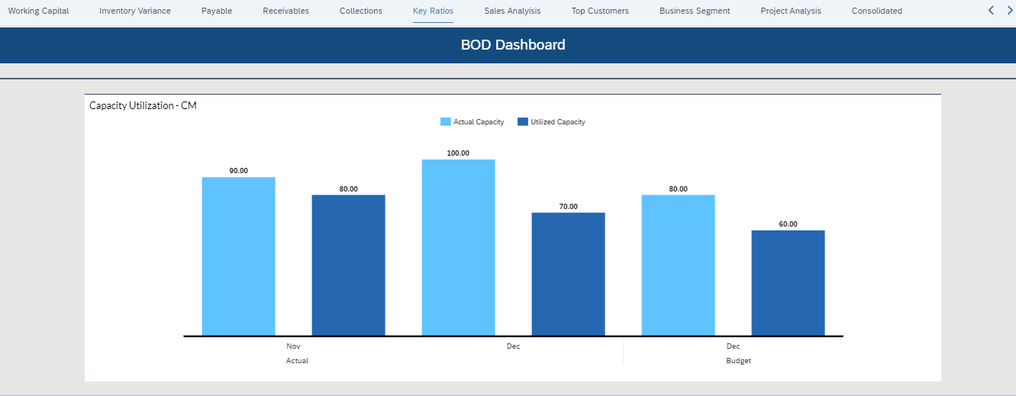
Al Rajhi - BOD Dashboard - Detailed Page

Slide 24
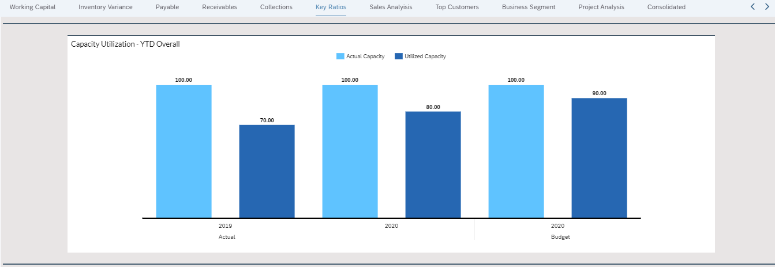
Al Rajhi - BOD Dashboard - Detailed Page

Slide 25
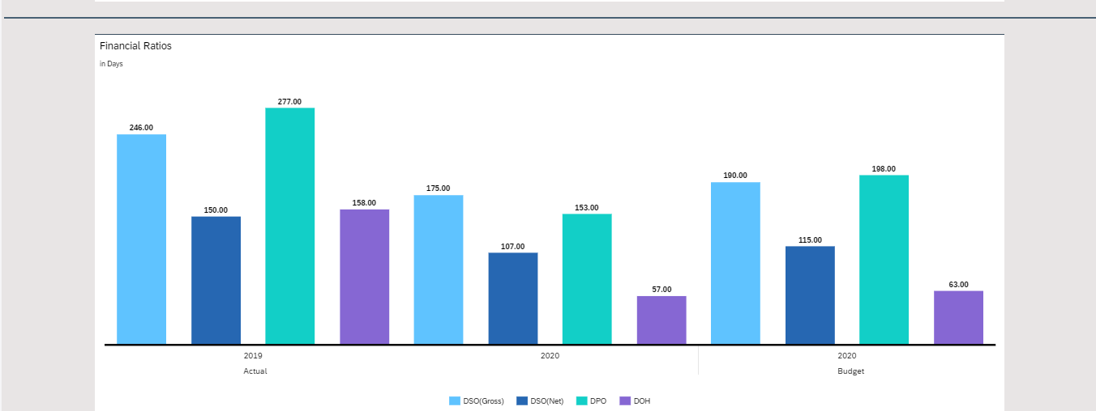
Al Rajhi - BOD Dashboard - Detailed Page

Slide 26
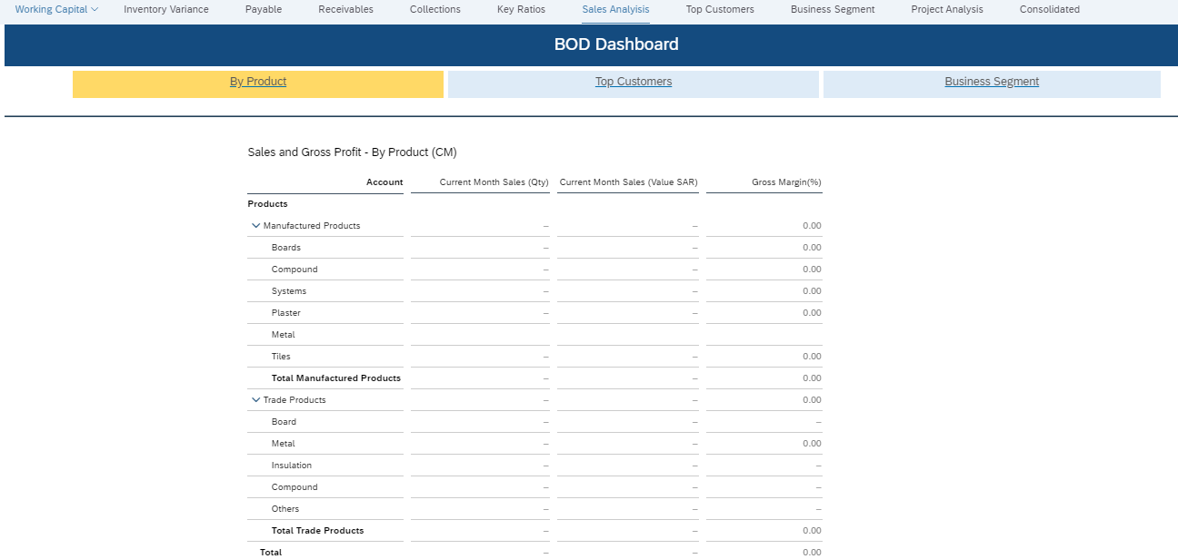
Al Rajhi - BOD Dashboard - Detailed Page

Slide 27
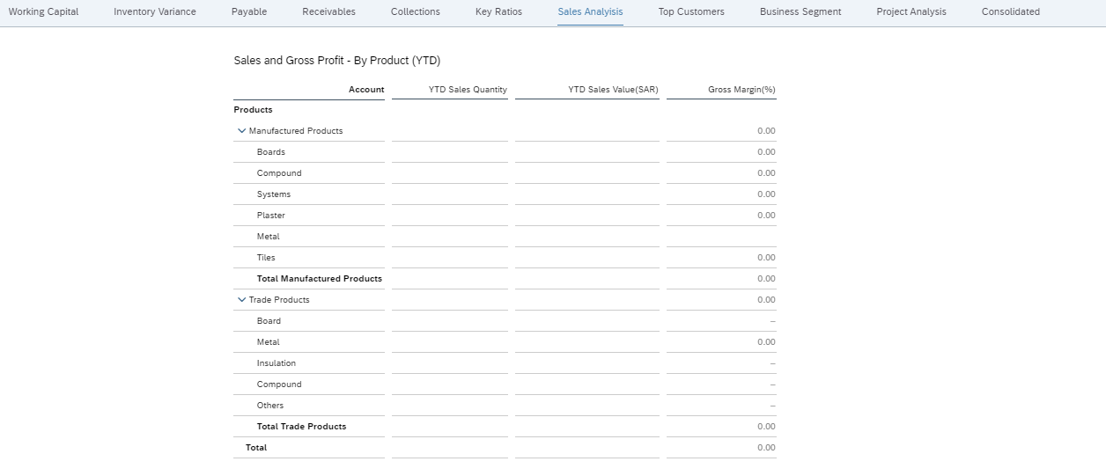
Al Rajhi - BOD Dashboard - Detailed Page

Slide 28
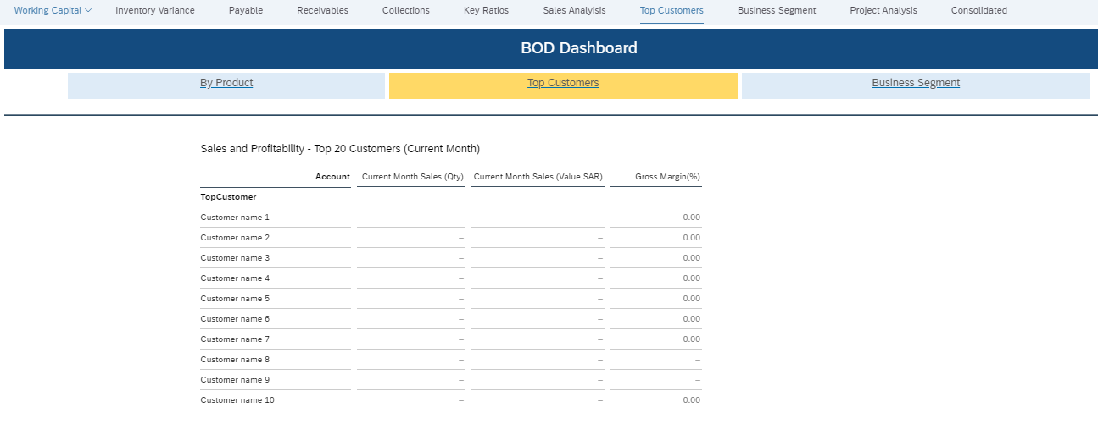
Al Rajhi - BOD Dashboard - Detailed Page

Slide 29
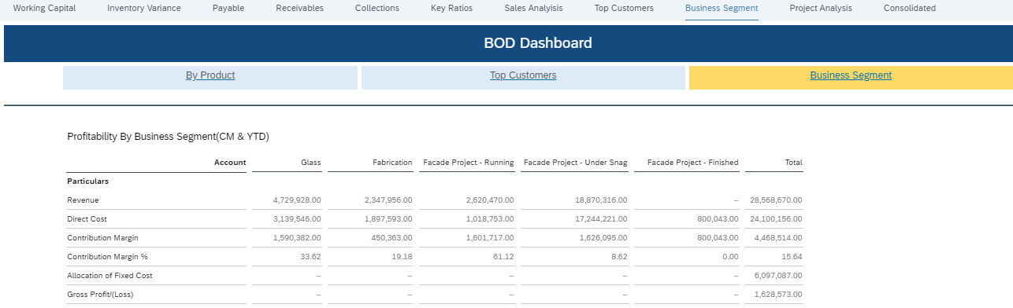
Al Rajhi - BOD Dashboard - Detailed Page

Slide 30
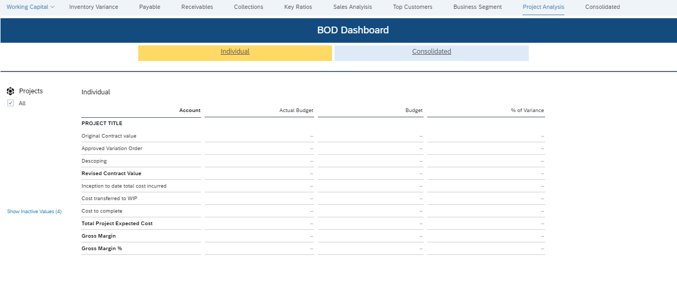
Al Rajhi - BOD Dashboard - Detailed Page

Slide 31
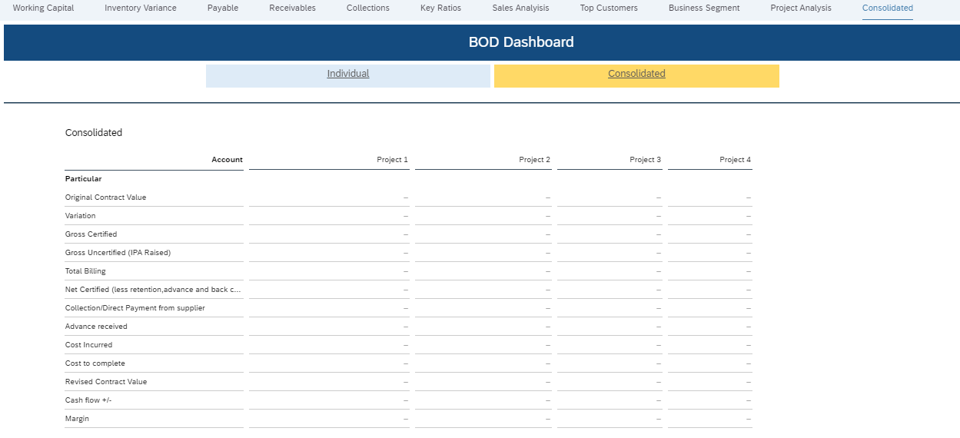
Al Rajhi - BOD Dashboard - Detailed Page

Slide 32
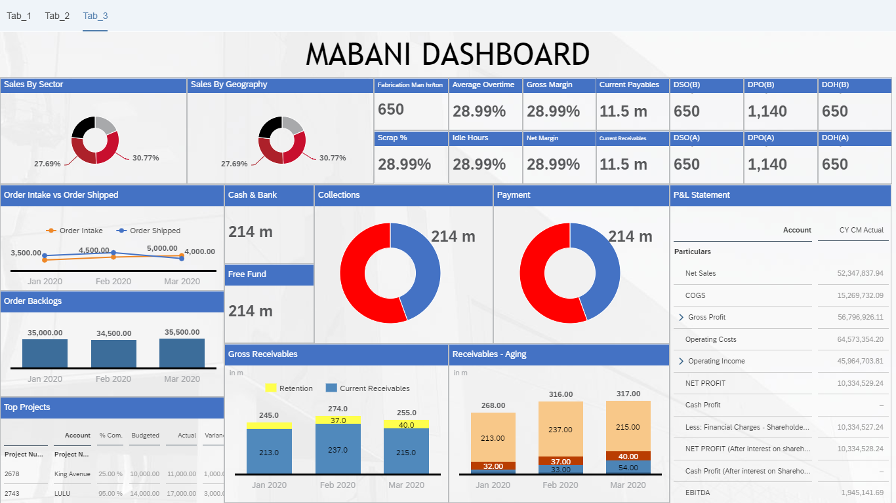
Al Rajhi - Mabani Steel Dashboard - Landing Page

Slide 33
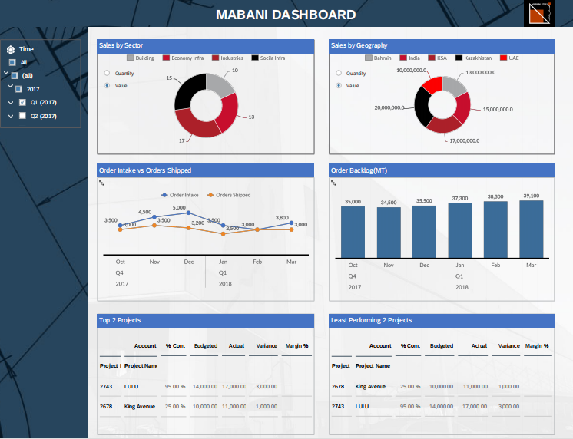
Al Rajhi - Mabani Steel Dashboard - Detailed Page - Sales & Production

Slide 34
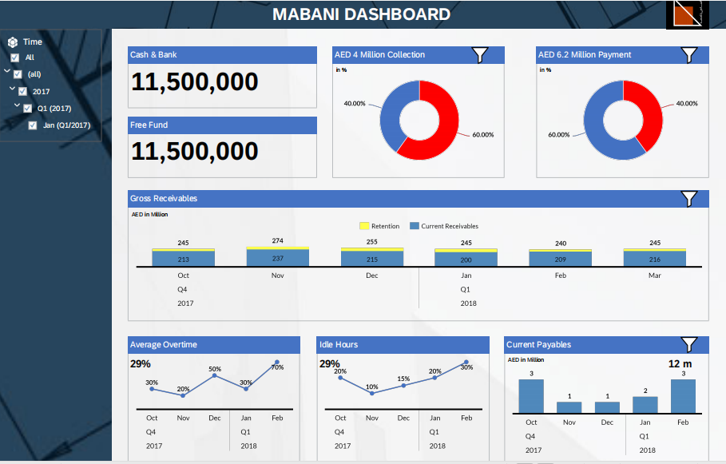
Al Rajhi - Mabani Steel Dashboard - Detailed Page - Finance

Slide 35
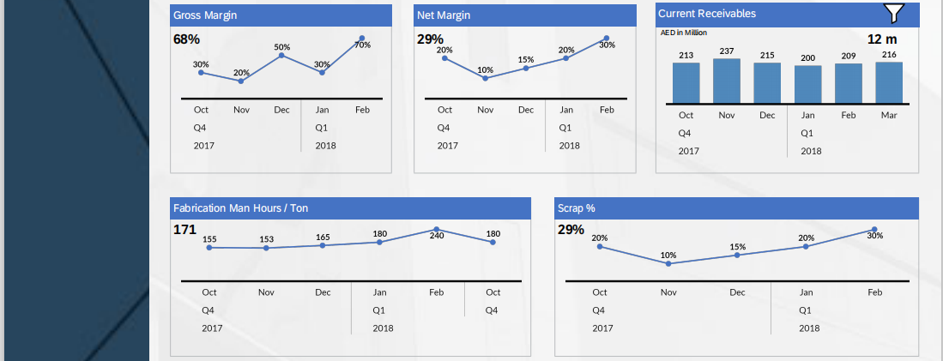
Al Rajhi - Mabani Steel Dashboard - Detailed Page - Finance (conti...)

Slide 36
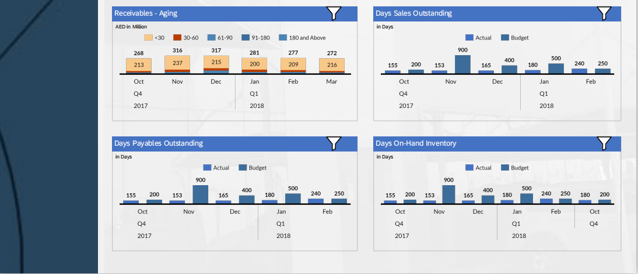
Al Rajhi - Mabani Steel Dashboard - Detailed Page - Finance (conti...)

Slide 37
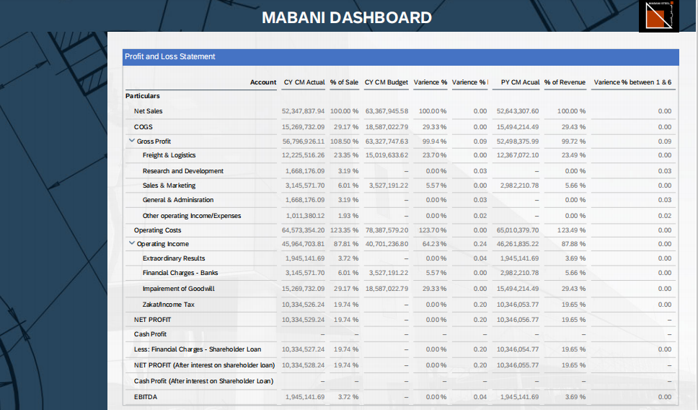
Al Rajhi - Mabani Steel Dashboard - Detailed Page - P & L Detailed

Slide 38
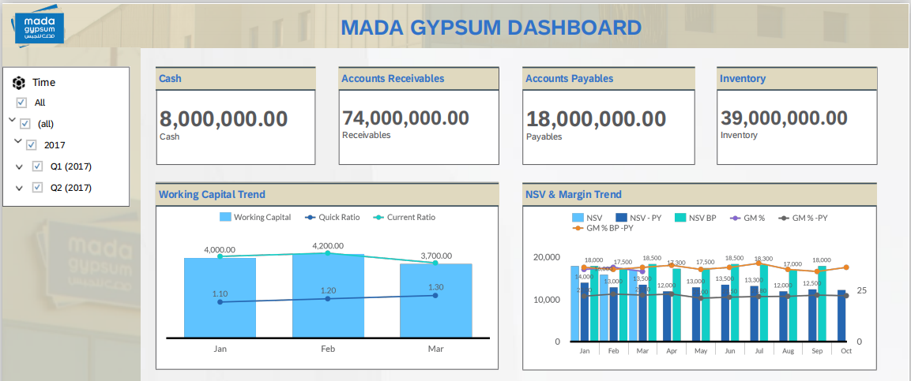
Al Rajhi - Mada Gypsum Dashboard - Landing Page

Slide 39
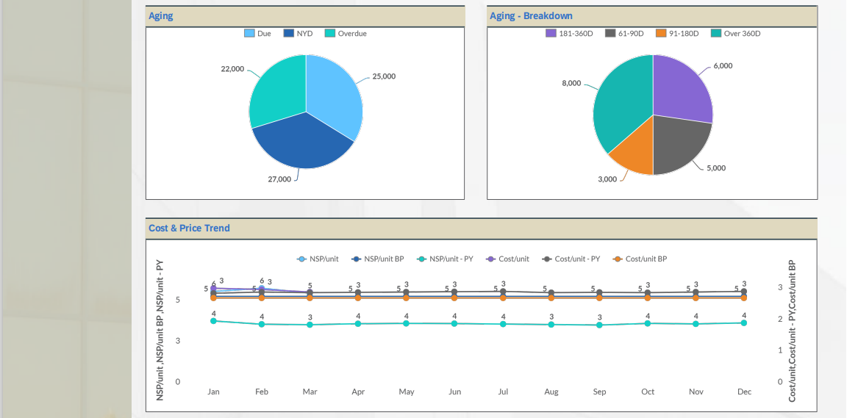
Al Rajhi - Mada Gypsum Dashboard - Landing Page (conti...)

Slide 40
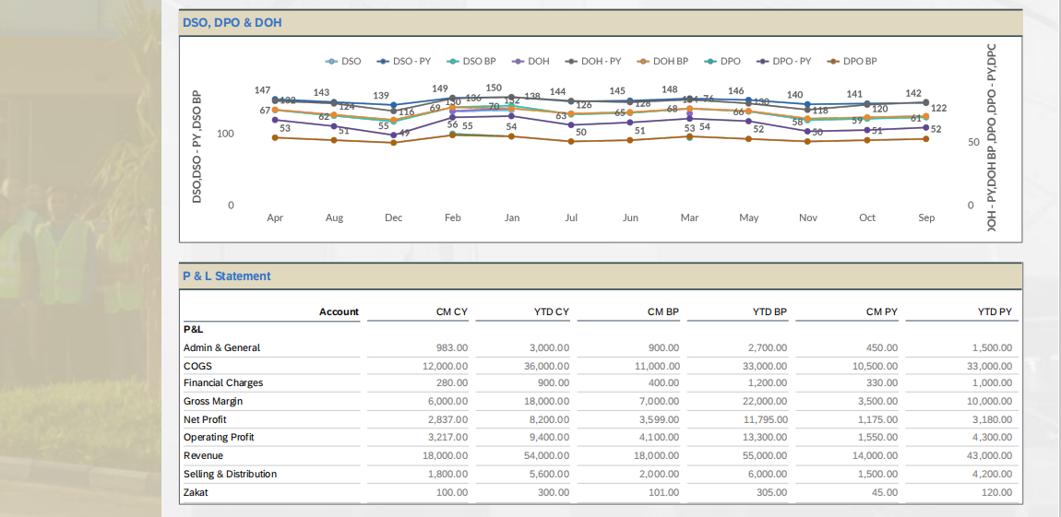
Al Rajhi - Mada Gypsum Dashboard - Landing Page (conti...)

Slide 41
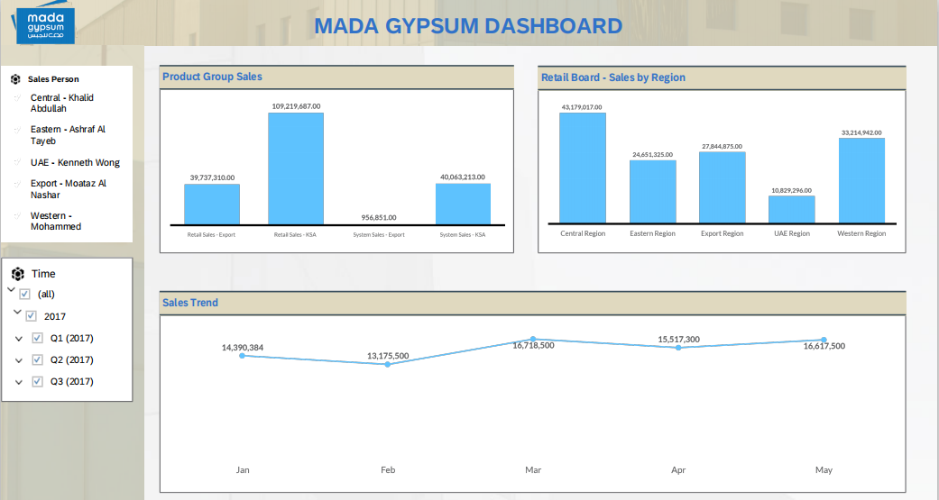
Al Rajhi - Mada Gypsum Dashboard - Detailed Page - Sales Dashboard Overview

Slide 42
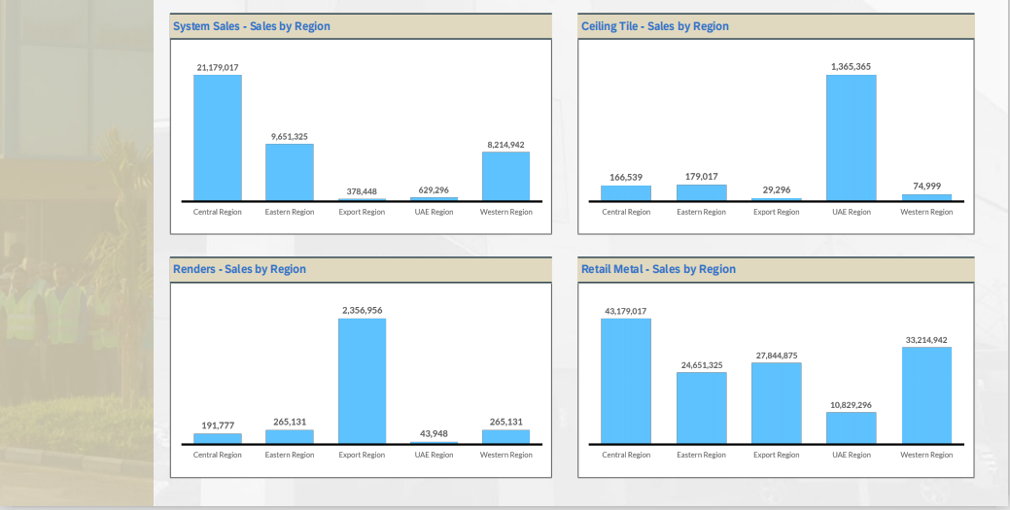
Al Rajhi - Mada Gypsum Dashboard - Detailed Page - Sales Dashboard Overview (conti...)

Slide 43
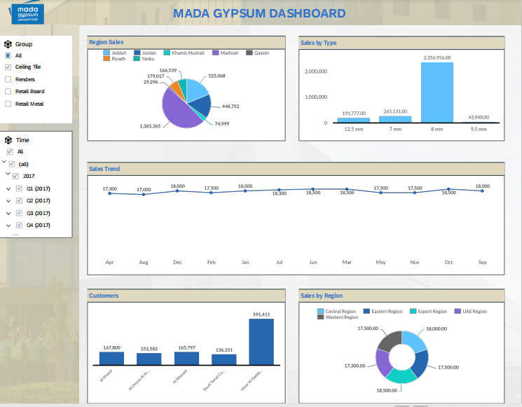
Al Rajhi - Mada Gypsum Dashboard - Detailed Page - Sales Trend

Slide 44
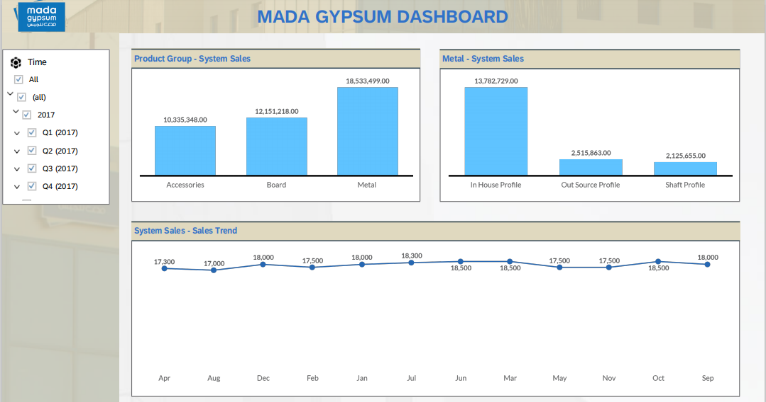
Al Rajhi - Mada Gypsum Dashboard - Detailed Page - System Sales

Slide 45
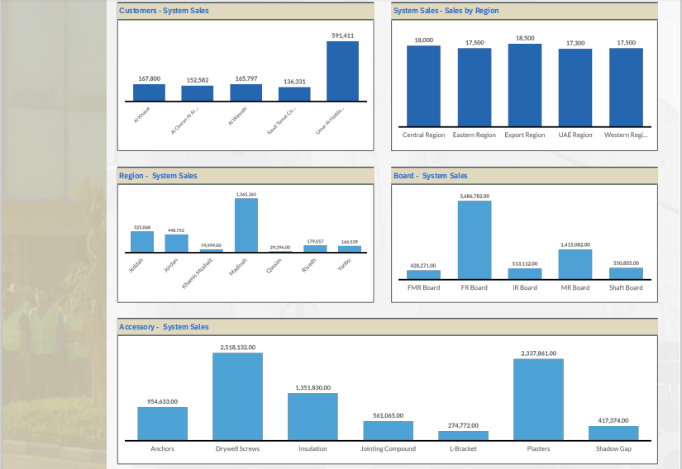
Al Rajhi - Mada Gypsum Dashboard - Detailed Page - System Sales (conti...)

Slide 46
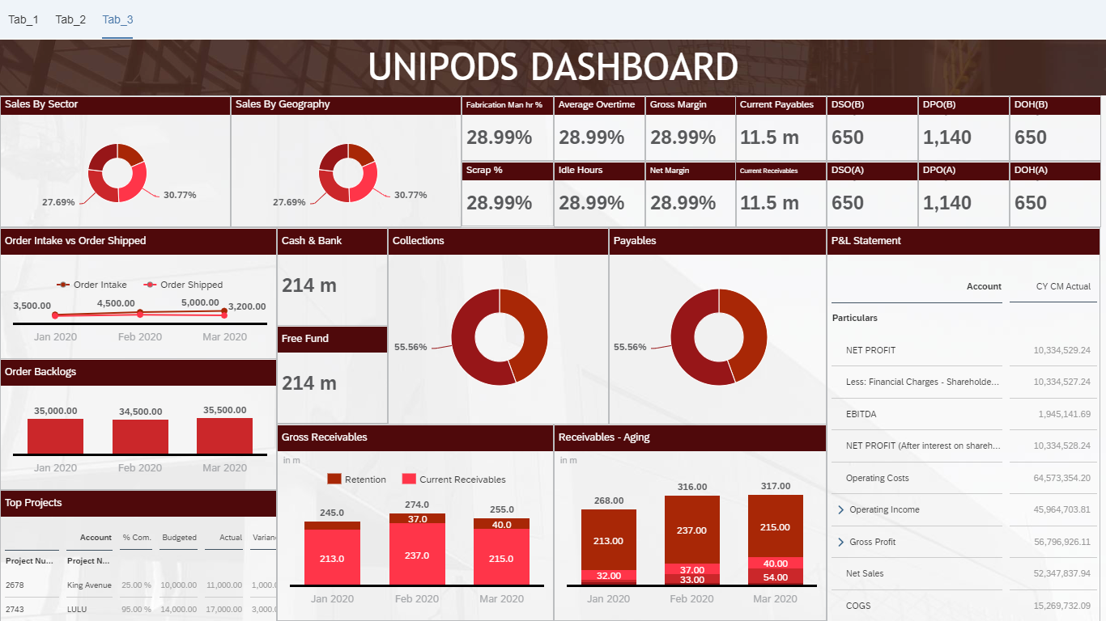
Al Rajhi - Unipods Dashboard - Landing Page

Slide 47
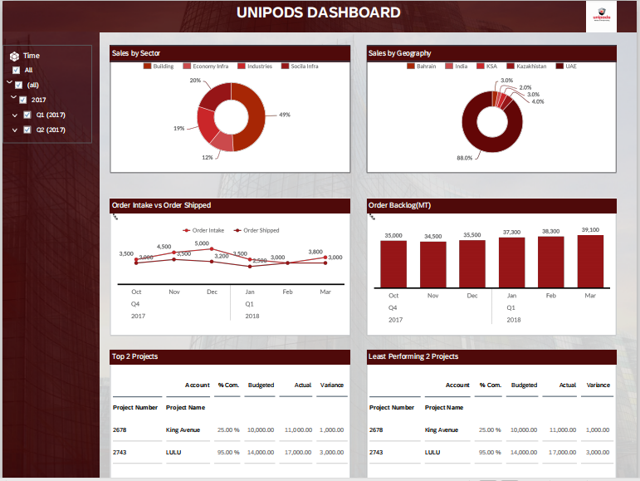
Al Rajhi - Unipods Dashboard - Detailed Page - Sales & Production

Slide 48
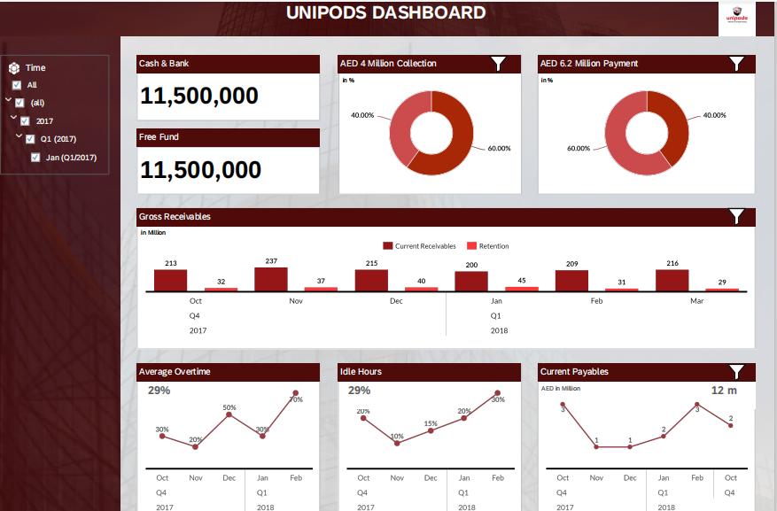
Al Rajhi - Unipods Dashboard - Detailed Page - Finance

Slide 49
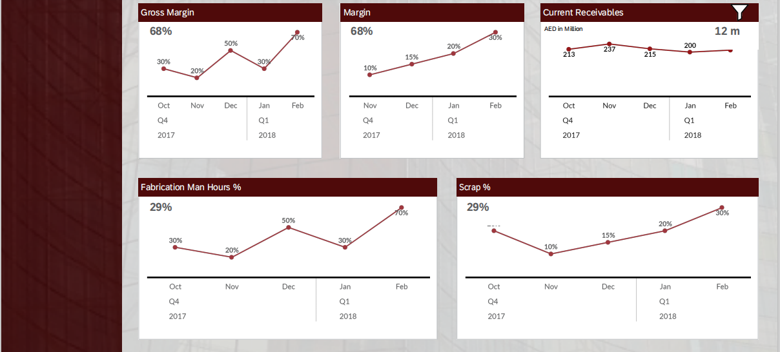
Al Rajhi - Unipods Dashboard - Detailed Page - Finance (conti...)

Slide 50
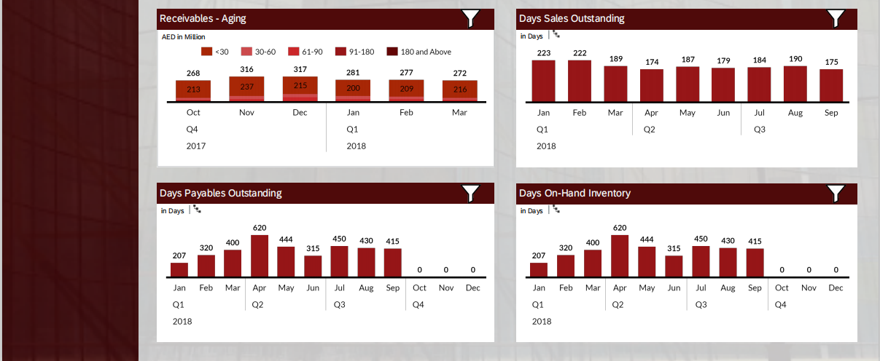
Al Rajhi - Unipods Dashboard - Detailed Page - Finance (conti...)

Slide 51
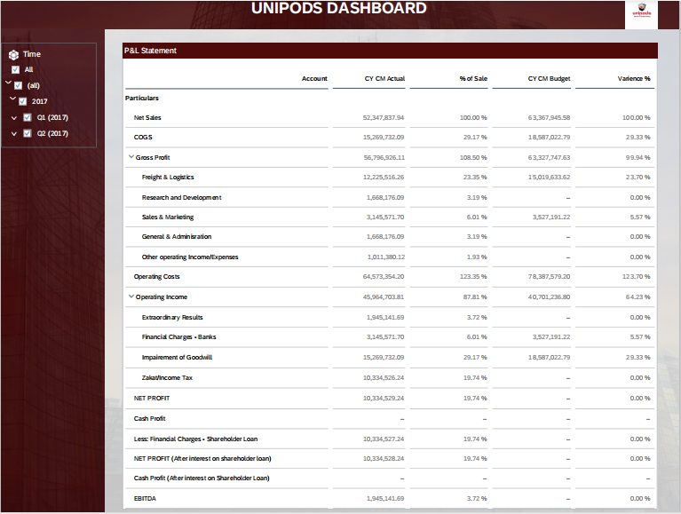
Al Rajhi - Unipods Dashboard - Detailed Page - Finance (conti...)

Slide 52
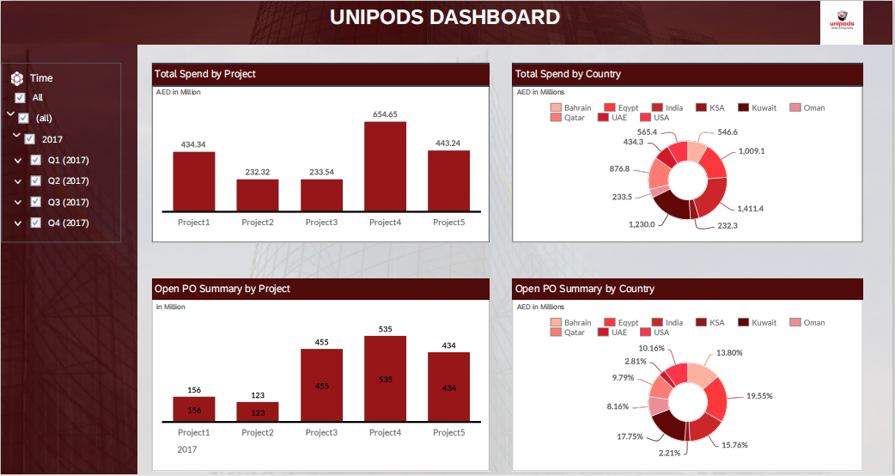
Al Rajhi - Unipods Dashboard - Detailed Page - Procurement & Production

Slide 53

Al Rajhi - Unipods Dashboard - Detailed Page - Procurement & Production (conti...)

Slide 54

Al Rajhi - Unipods Dashboard 2

Slide 55

Al Rajhi - Unipods Dashboard 2 (conti...)

Slide 56

Al Rajhi - Unipods Dashboard 2 (conti...)

Slide 57

Al Rajhi - Cladtech Dashboard - Sales & Production

Slide 58

Al Rajhi - Cladtech Dashboard - Finance

Slide 59

Al Rajhi - Cladtech Dashboard - Finance (conti...)

